Slide 1

Cronos Frontier
CIT:178 Example Database

Slide 2

Table of Contents
Database Diagram
Cronos Frontier Projects
Project Assignments
Employees
Autonomous Operators
Operator Assignments
Job Codes
Summary Queries
Stored Procedures
Functions
Triggers

Slide 3

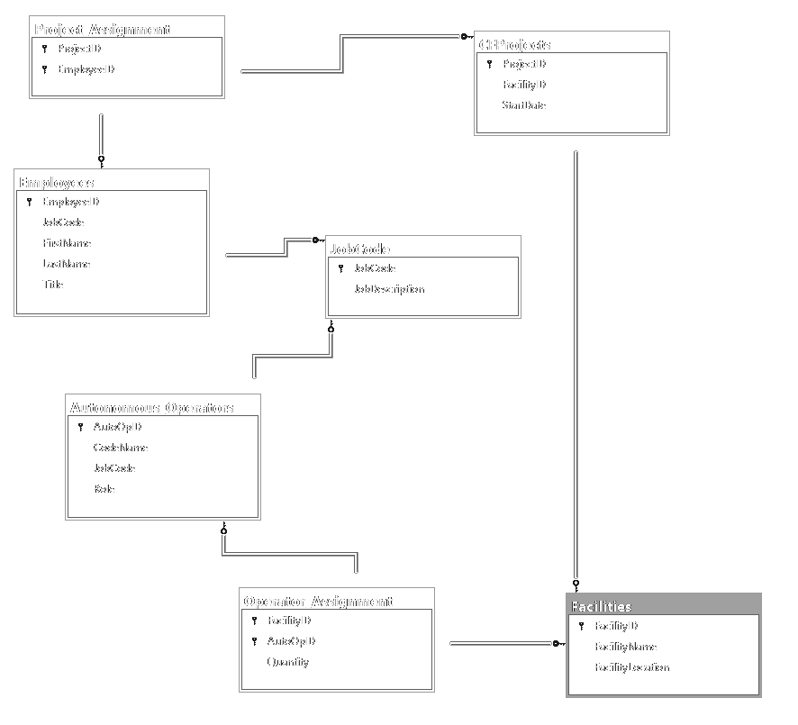
DATA BASE DIAGRAM

Slide 4
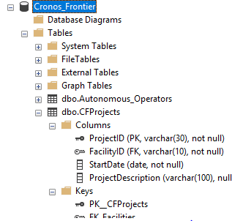
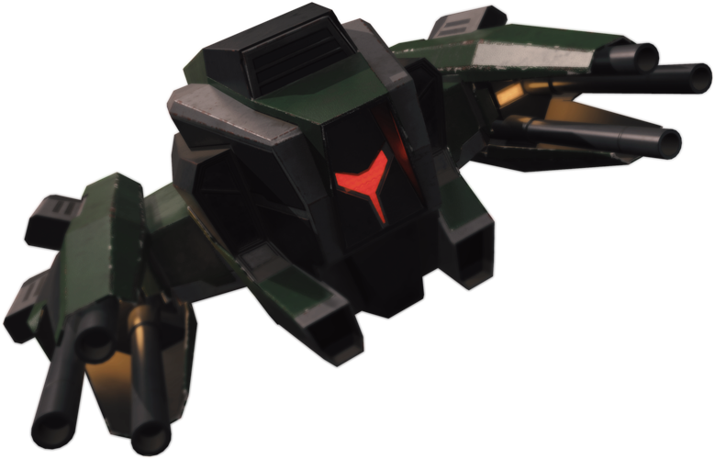
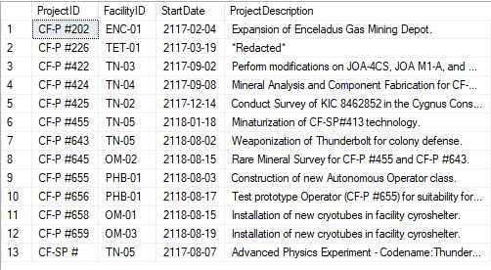
Cronos Frontier
Projects
This table stores project information, including facility of origin, start date, and a brief description as to what the project goals are.

Slide 5
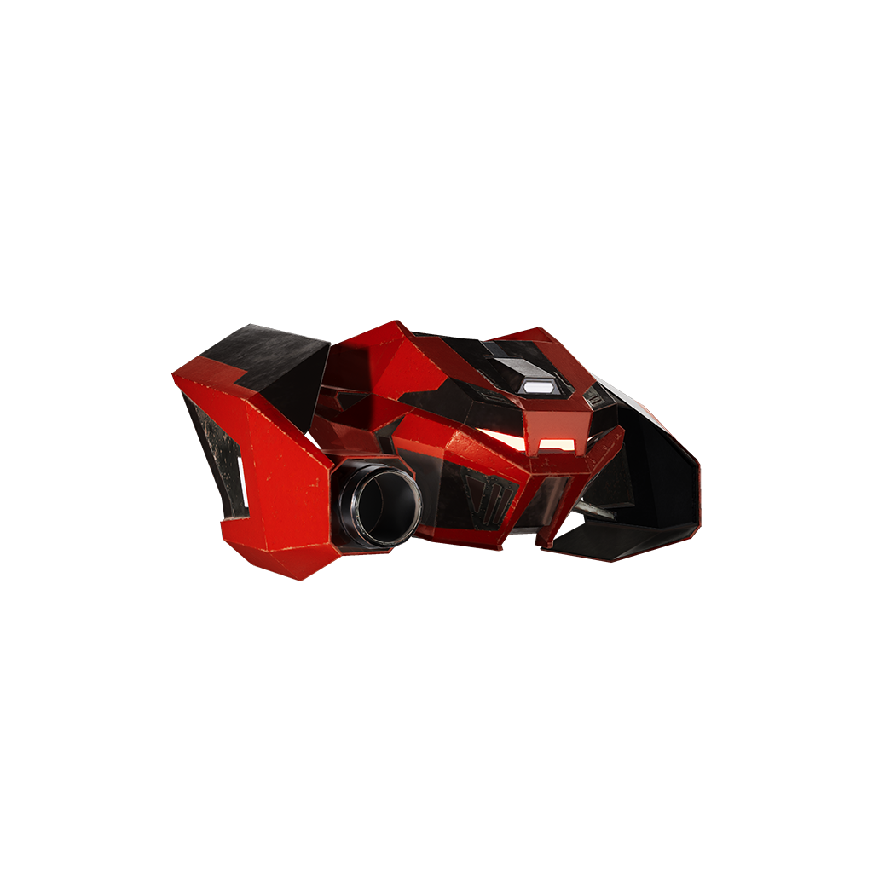
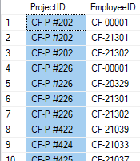
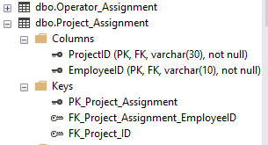
Project Assignments
This table links the project assignments table with the employees table, detailing which employees are assigned to which projects.

Slide 6

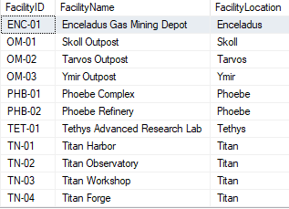
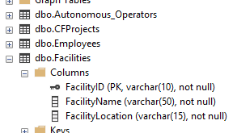
Facilities
Facilities
This table stores information about Cronos Frontier Facilities, including the full name and which moon of Saturn the facility is located

Slide 7

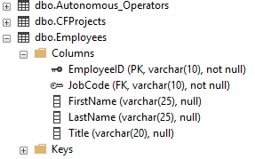
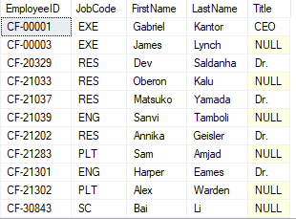
Employees
This table stores employee information, including Job Code, Name, and Title where appropriate.

Slide 8

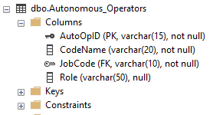
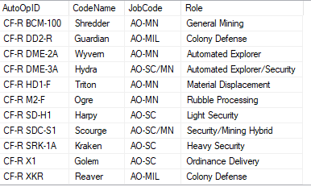
Autonomous Operators
This table stores information about Cronos Frontier’s Autonomous Operators (robots), including name, job code, and what role they perform.

Slide 9
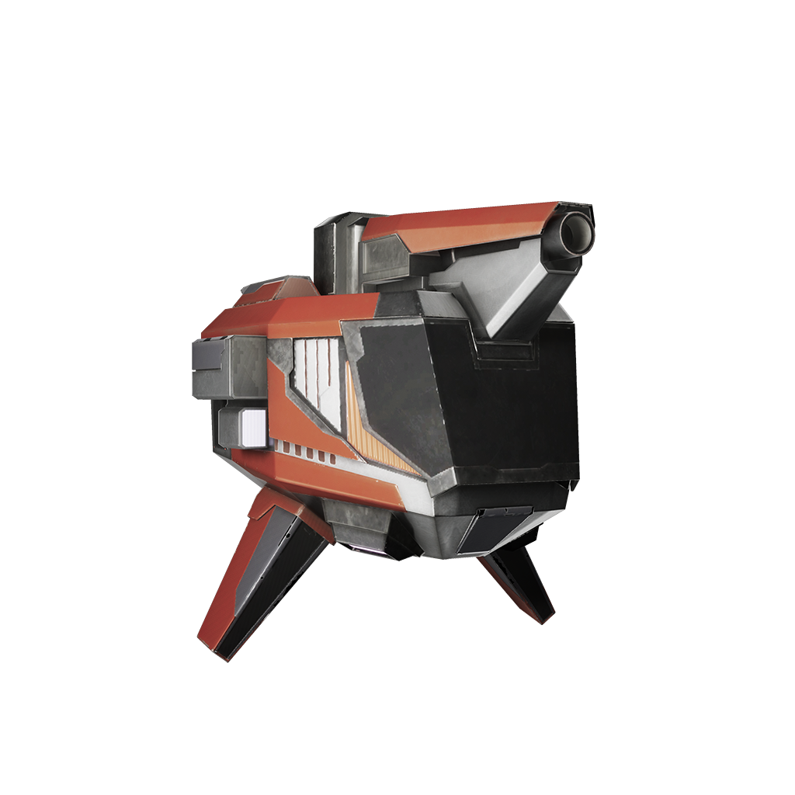
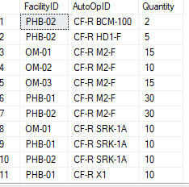
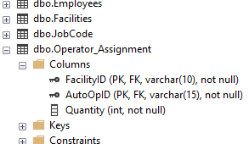
Operator Assignment
This table links Autonomous Operators with Facilities and includes the number of Operators assigned to a facility.

Slide 10
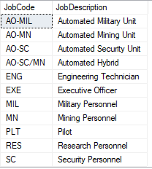
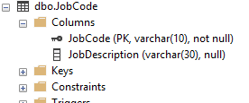
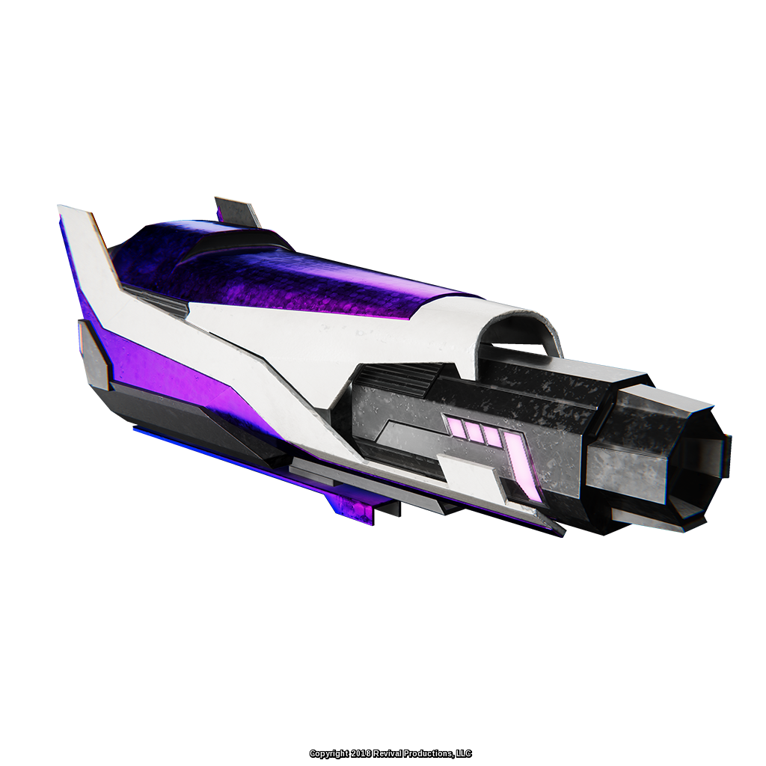
Job Code
This table stores job code information and provides a description of each job’s responsibilities.

Slide 11
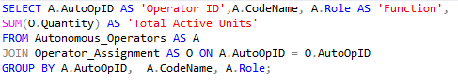
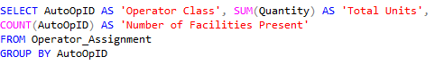
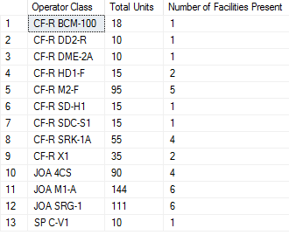
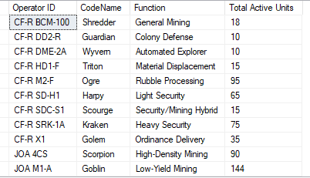
Summary Queries
Active Units Query
Facility Count Query

Slide 12
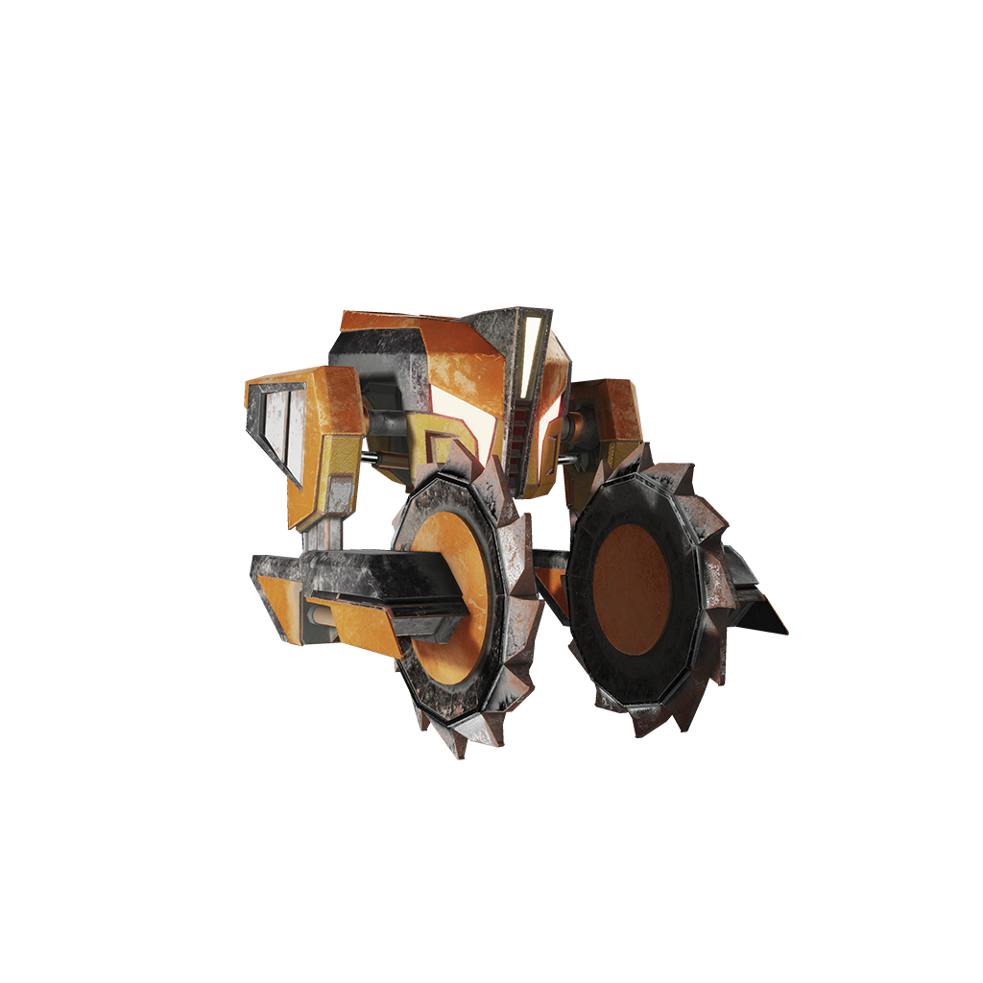
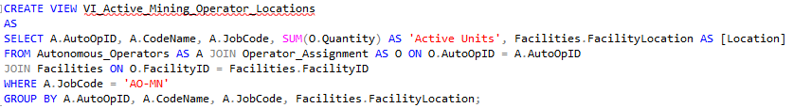
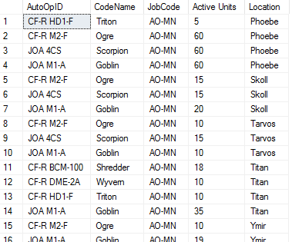
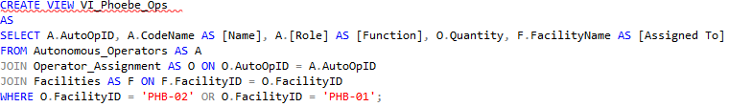
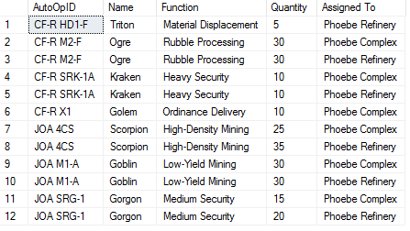
Database Views
Active Mining Operators Locations
Phoebe Operators

Slide 13
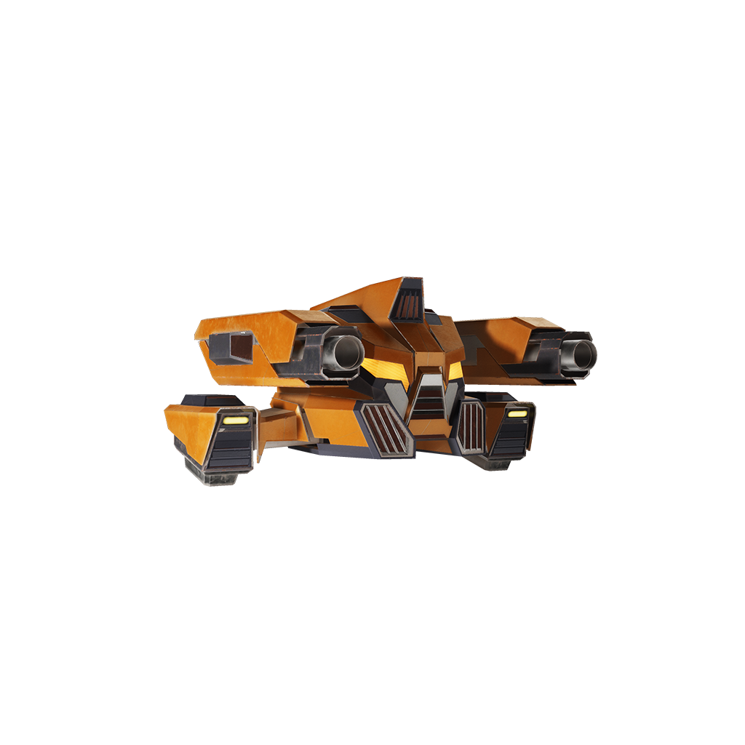
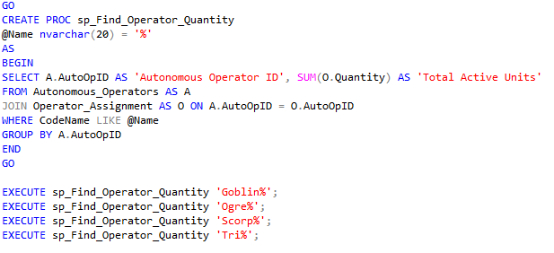
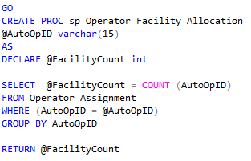
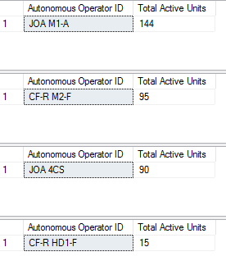
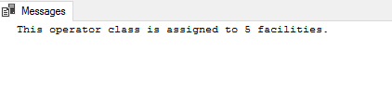
Stored Procedures
SP Find Operator Quantity
SP Facility Allocation

Slide 14
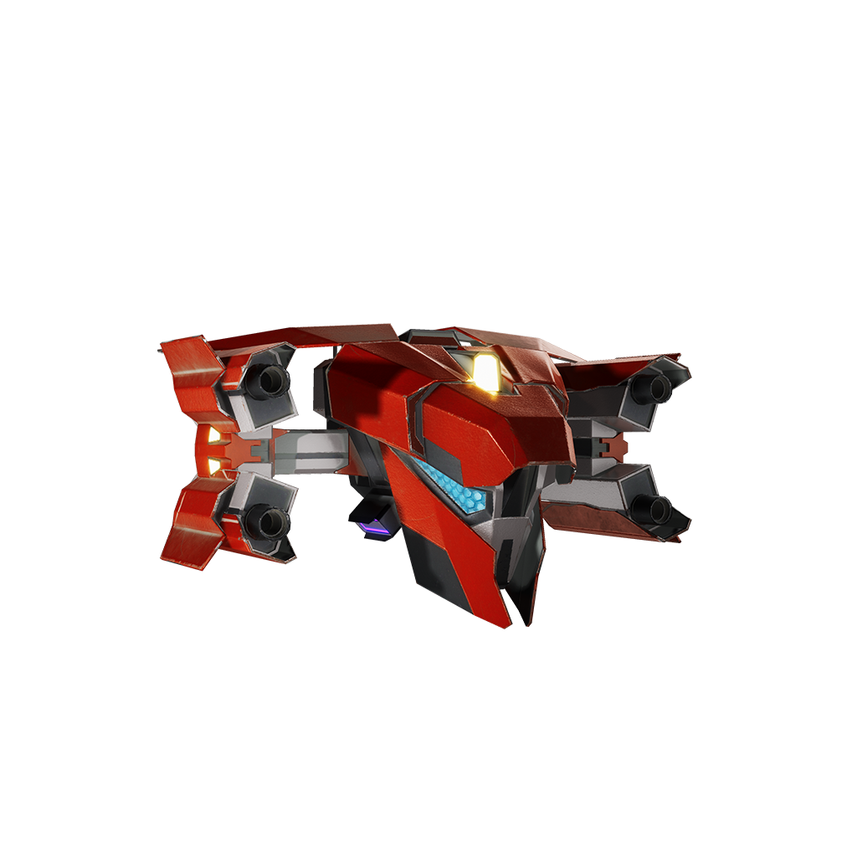
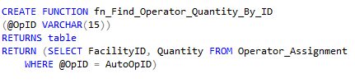
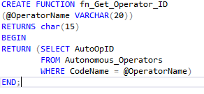
Functions
This function finds and displays the quantity of active units using the identification number of a given autonomous operator class.
For instance, inputting “CF-R SRK-1A” will prompt the function to find the current active number of Kraken units across all Cronos Frontier facilities.
This function locates the ID of a given Operator Class through the codename. Inputting “Kraken” for instance will return CF-R SRK-1A.

Slide 15

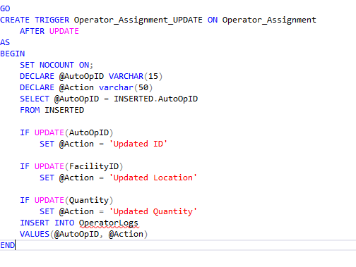
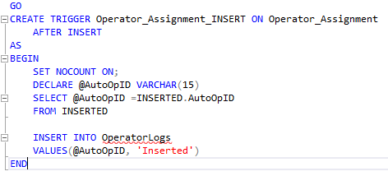
Triggers
This trigger logs whenever new information is added to the Operator Assignment table.
It adds a row to the Operator Logs table stating which operator ID was added to the Operator Assignment Table.
This trigger logs updates to the Operator Assignment table and records what type of update was made to the table.

Slide 16

END
Overload and related content are copyright Revival Productions LLC.

